Slide 1
Setup of test environment

Slide 2
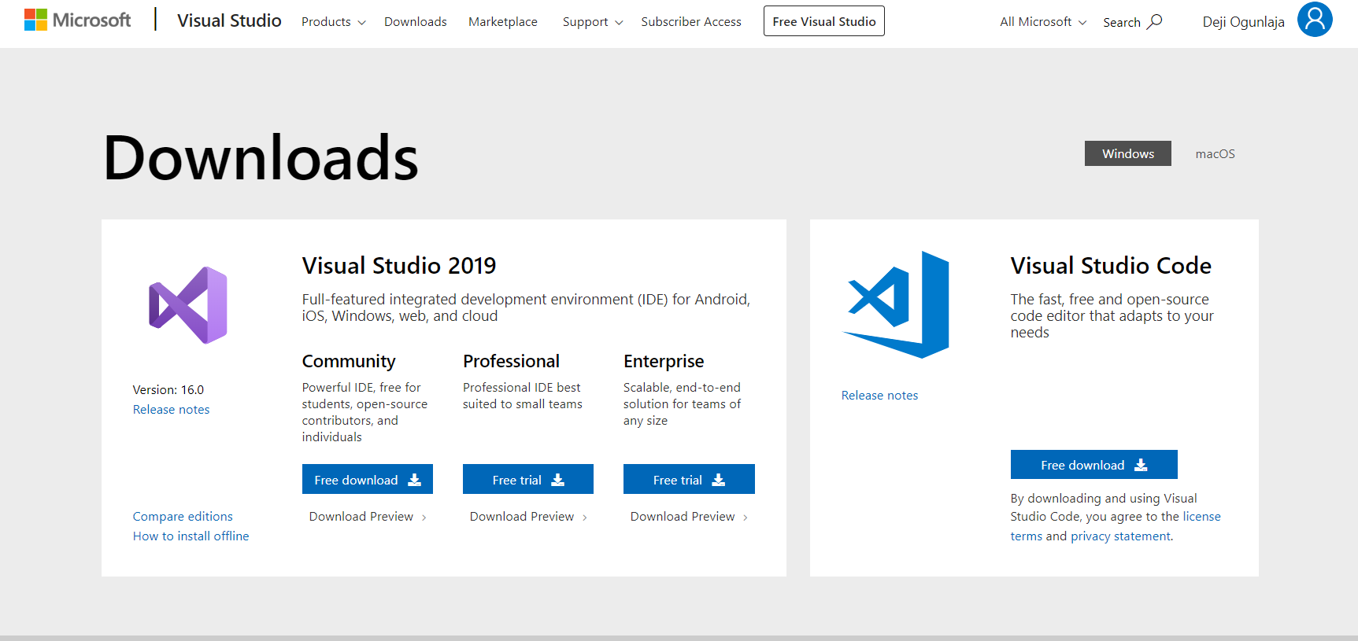
Install Visual Studio
https://visualstudio.microsoft.com/downloads/
Click Download on Community

Slide 3
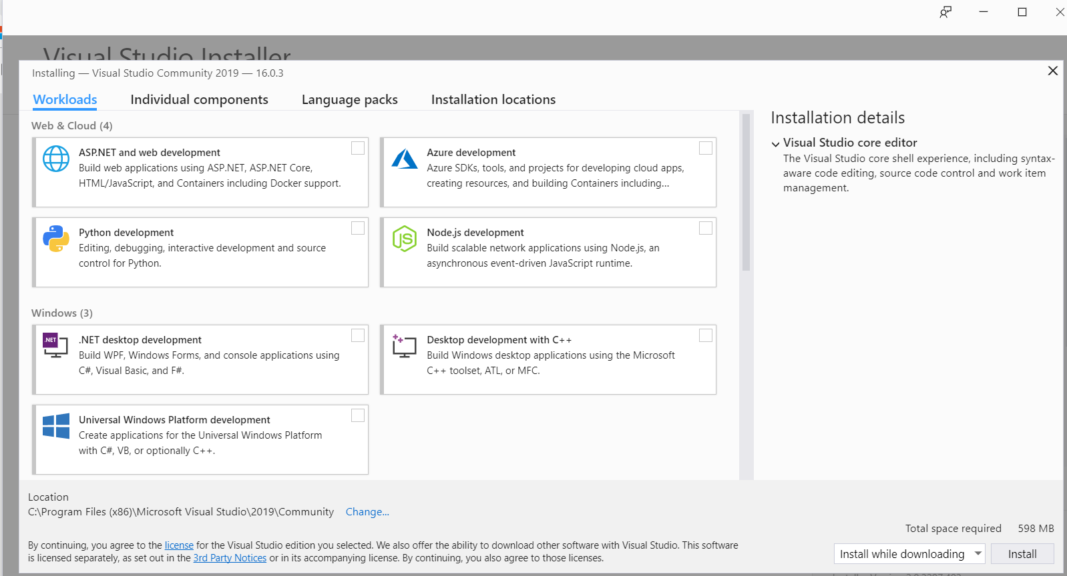
Select Install while downloading
Click Install

Slide 4
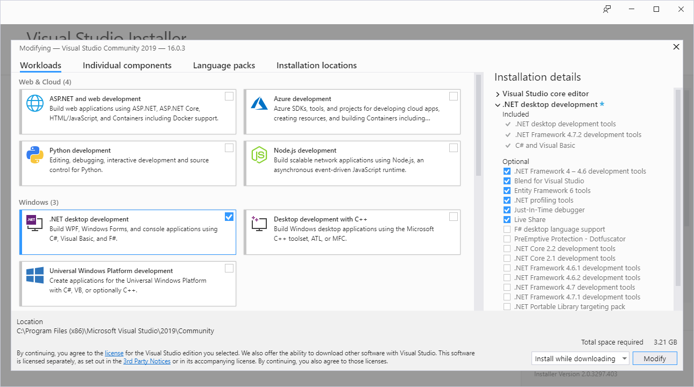

Slide 5
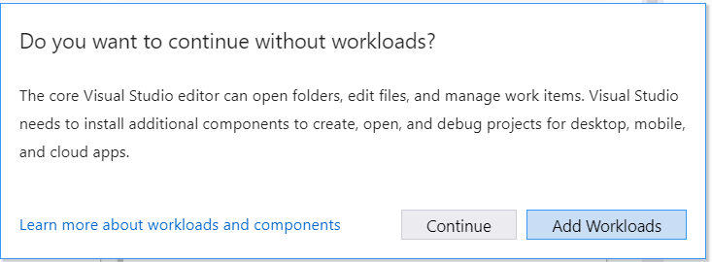
Click Add Workloads

Slide 6
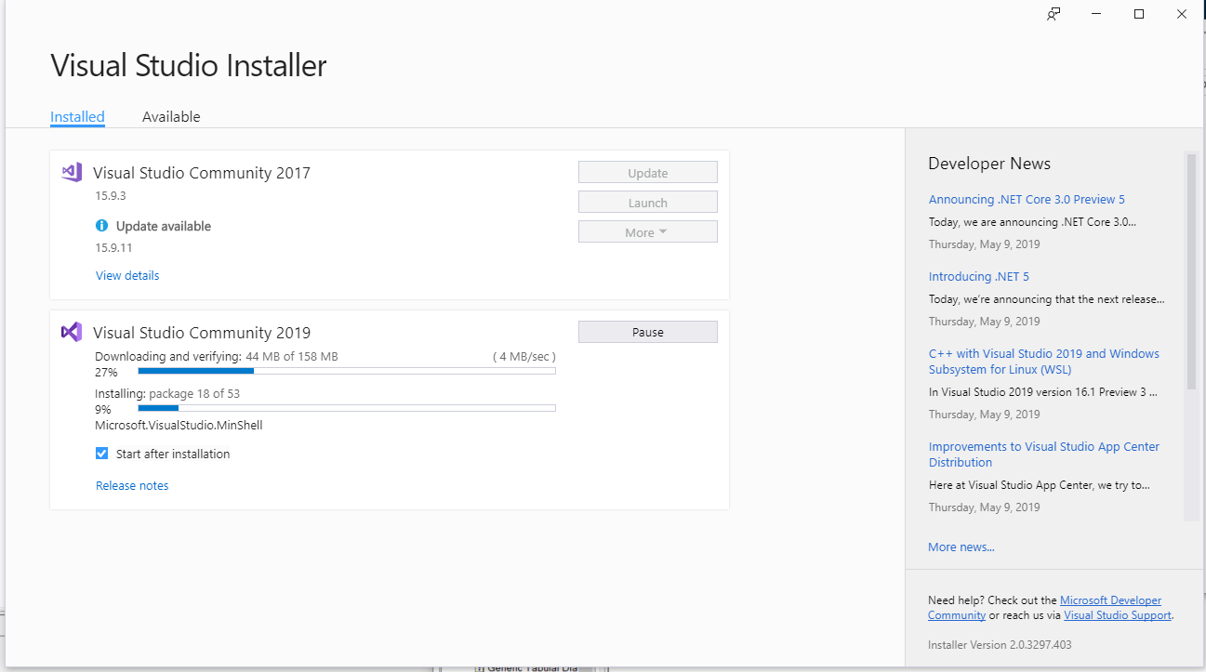

Slide 7
Install Windows AppDriver
http://appium.io/docs/en/drivers/windows/
https://github.com/Microsoft/WinAppDriver

Slide 8
Install Windows SDK (Optional)
https://developer.microsoft.com/en-us/windows/downloads/windows-10-sdk

Slide 9
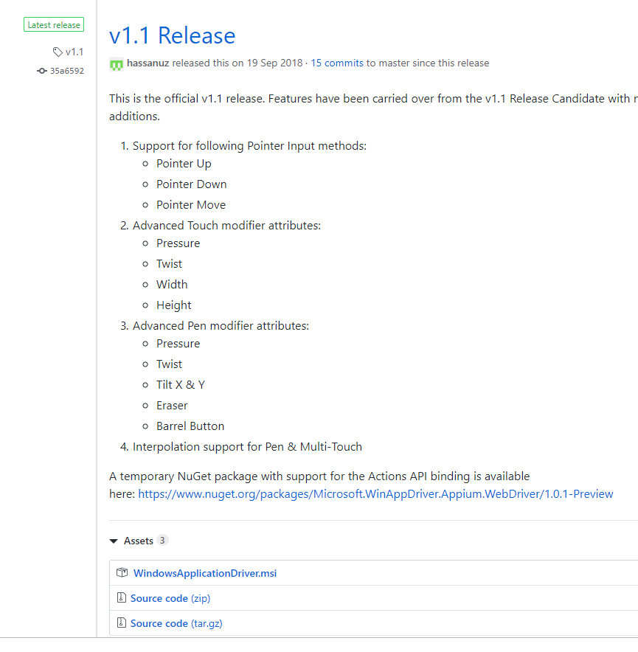
Go to https://github.com/Microsoft/WinAppDriver/releases
Click on the recent stable release eg
Download the MSI
And install

Slide 10
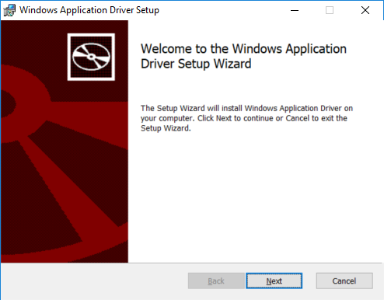

Slide 11
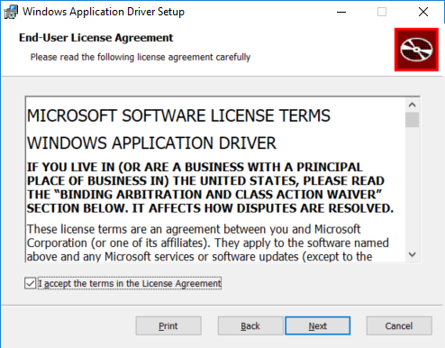

Slide 12
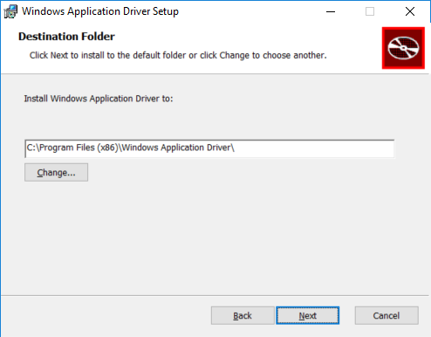

Slide 13
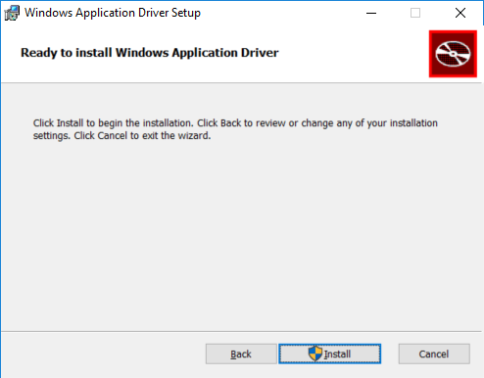

Slide 14
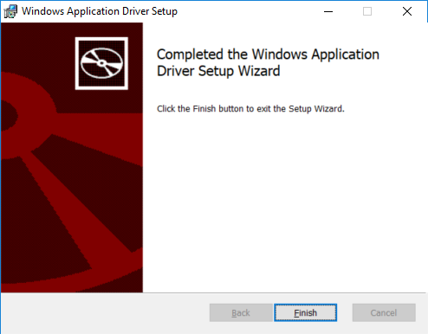

Slide 15
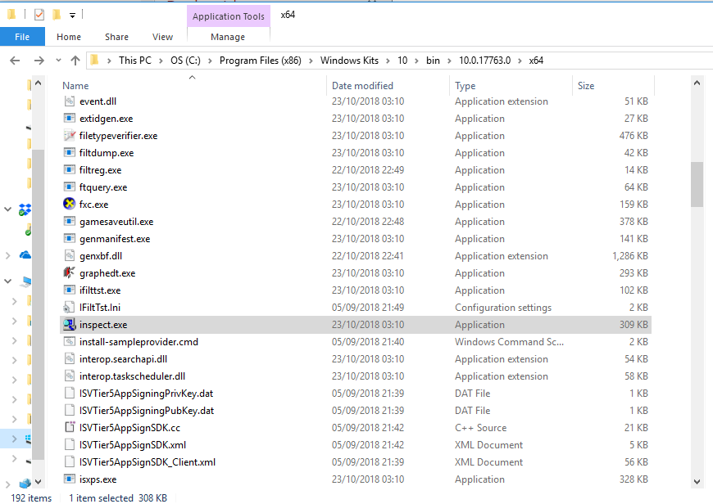
Start the Inspect tool
Open Inspect.exe to inspect objects on forms
Open the file C:\Program Files (x86)\Windows Kits\10\bin\10.0.17763.0\x64\inspect.exe

Slide 16
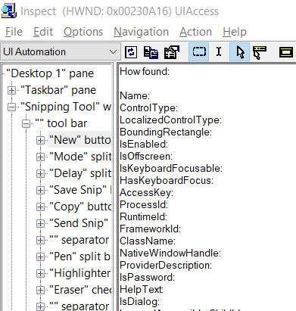
Inspect.exe

Slide 17
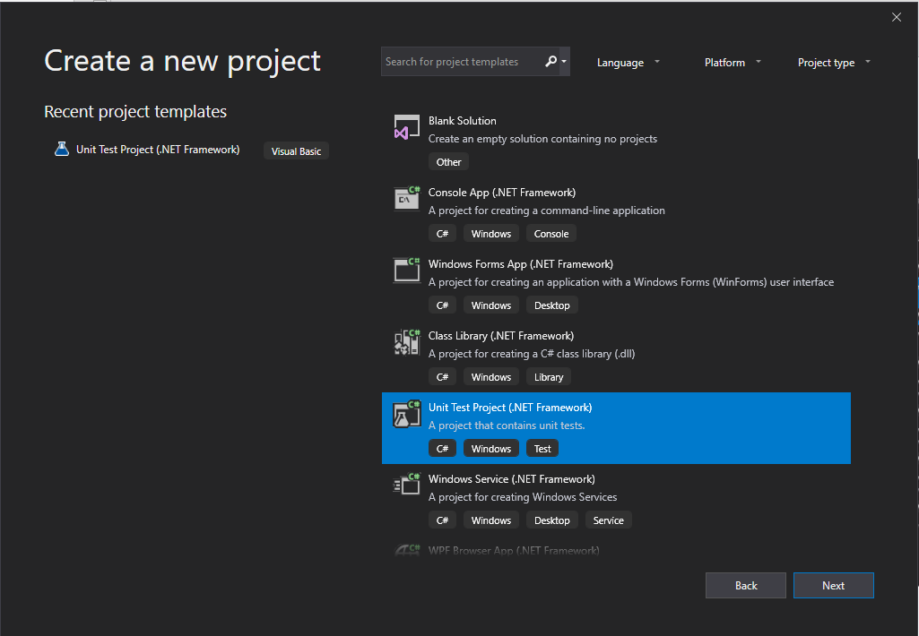
Create a new Project
Open Visual Studio
Click File
Click New
Select Unit Test Project (.NET Framework) as template to use for C#
Make sure it is the C# unit test project
Click Next

Slide 18
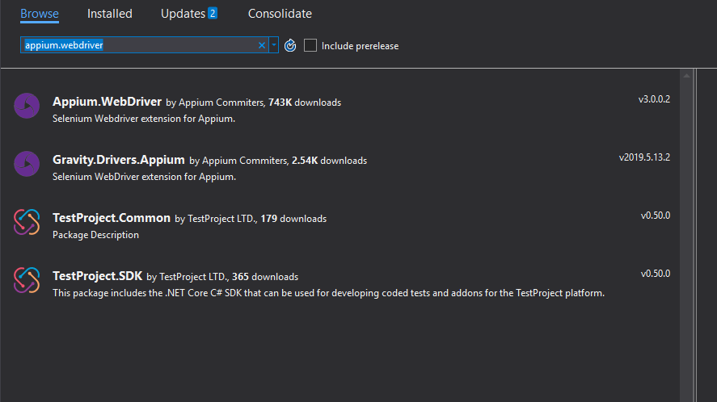
Add Appium.WebDriver to the Nugget Package

Slide 19
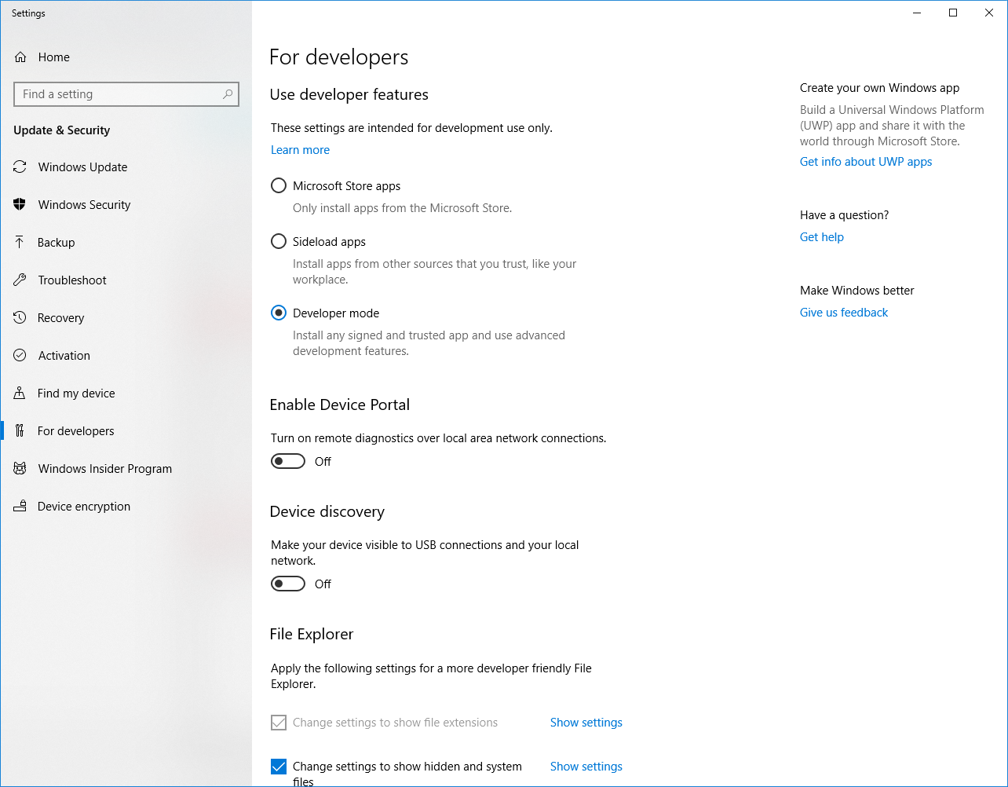
Set the developer Mode

Slide 20
Start the remote driver
C:\Program Files (x86)\Windows Application Driver\WinAppDriver.exe
The remote driver need to be running at the background.
The test framework starts this application automatically.

Slide 21
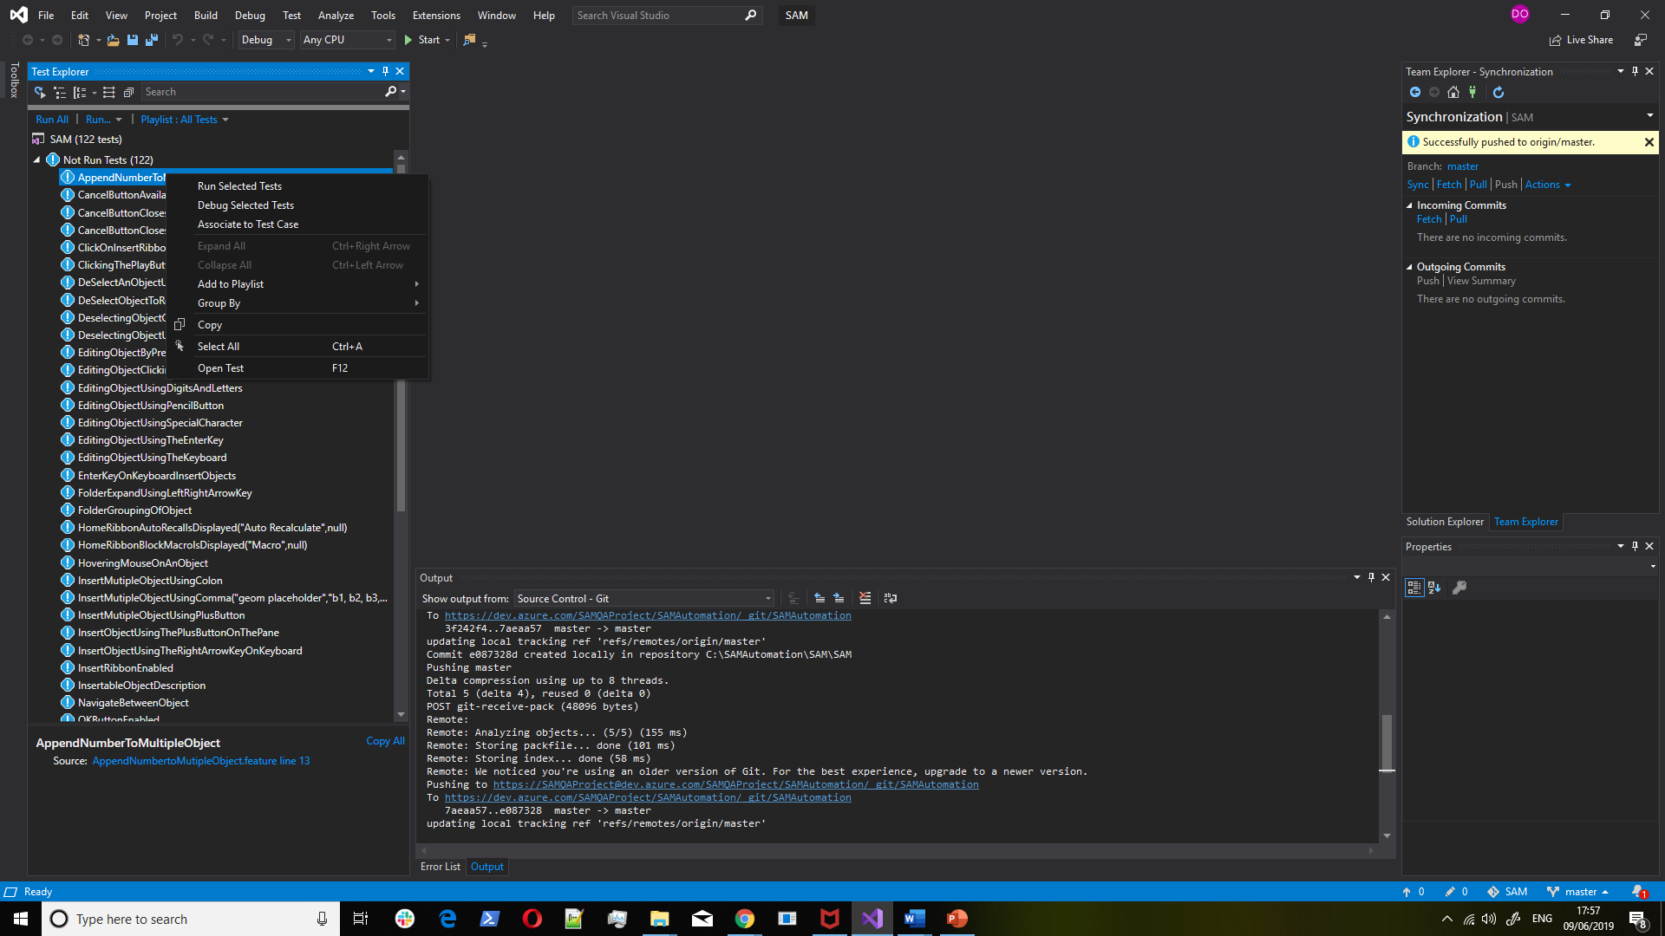
Run the test

Slide 22
Running the Report
…\SAM\Reports\ReportGenerator.bat

